Slide 1


Rain Gardens
Carla Hardy
West Virginia Conservation Agency
In cooperation with the Chesapeake Bay Program

Slide 2
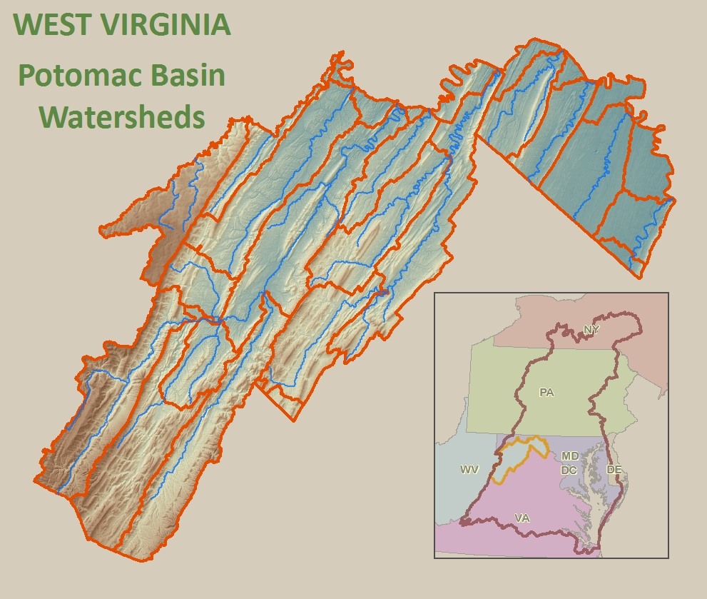
WV's Chesapeake Bay Program
Reduction of
Nutrients
  Nitrogen
  Phosphorous
Sediment
Other

Slide 3
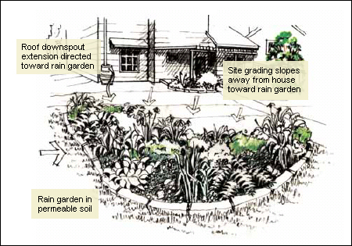
Your Personal Contribution to Cleaner Water- Catch On!
A "rain garden" is a man-made depression in the ground that is used as a landscape tool to improve water quality. The rain garden forms a "bioretention area" by collecting water runoff and storing it, permitting it to be filtered and slowly absorbed by the soil.
Graphic compliments of Sleepy Creek Watershed Association
Notes:
The bioretention concept is based on the hydrologic function of forest habitat, in which the forest produces a spongy litter layer that soaks up water and allows it to slowly penetrate the soil layer. The site for the rain garden should be placed strategically to intercept water runoff.

Slide 4
Why are rain gardens important?
As cities and suburbs grow and replace our forests and agricultural land, increased runoff from impervious surfaces becomes a problem.
Storm water runoff from developed areas increase flooding; carries pollutants from streets, parking lots and even lawns to local streams; and leads to costly municipal improvements in storm water treatment.

Slide 5
Small thing? Yes.
Collectively- Big Benefits!
Increased filtration
Recharge aquifers
Protection from flooding and drainage problems
Water quality protection from pollutants
Enhanced beauty
Habitat for wildlife
Low maintenance!

Slide 6
Who Should Create a Rain Garden
Rain gardens are suitable for any land use situation - residential, commercial, and industrial. A rain garden should be placed so that impervious surfaces will drain into the depression area. Its purpose is to minimize the volume and improve the quality of water entering conventional storm drains and nearby streams and rivers.

Slide 7
FAQ’s
Does a rain garden form a pond?
No, the rain water will soak in so that the garden is dry between rainfalls.
Are they a breeding ground for mosquitoes?
No, mosquitoes need 7 to 12 days to lay eggs and hatch- water will stand in garden only a few hours.
Do they require lots of maintenance?
They can be maintained with little effort after the plants are established. Some weeding and watering will be needed first year or two.
Is a rain garden expensive?
It doesn’t have to be!

Slide 8
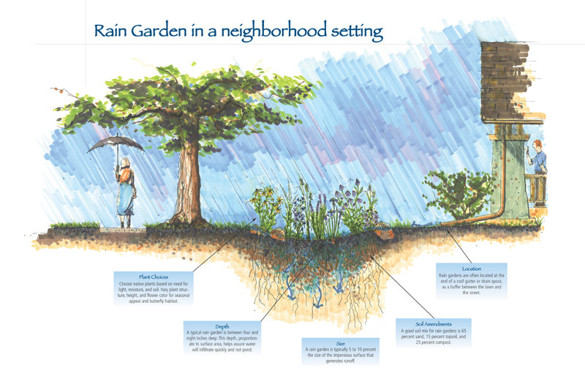
Graphic compliments of Sleepy Creek Watershed Association
Notes:
A nutrient removal or "filtering" process takes place as the water comes in contact with the soil and the roots of the trees, shrubs, and vegetation. This process accounts for the improved water quality. The first flush of rain water is ponded in the depression of the rain garden, and contains the highest concentration of materials washed off impervious surfaces such as roofs, roads, and parking lots.

Slide 9
Choosing the Right Spot
Take advantage of existing drainage pattern
Note direction of runoff and where water collects by using the “water hose method”
Resist areas where water stands
Every site is unique!
Check your soils

Slide 10
Tips for Location
Avoid creating your garden too close to your building foundation
At least 10 feet and down slope from a building
Stay away from septic drain field
Call MISS UTILITY before digging!- 1-800.245.4848 –
Avoid service lines or utilities
Try not to put your garden directly under a tree- needs full or partial sun

Slide 11
Design With End In Mind!
Integrate into existing and future landscaping
Pay attention to views from inside and outside the house as well as throughout the landscape
Think diversity and mix it up
Sketch it first

Slide 12
Sizing your garden
Typical rain garden ranges from 100 to 300 square feet.
Sizing will depend upon:
  How deep the garden will be
  Type of soil
  How much drainage area you will be handling
  Will drainage flow directly into garden via PVC piping or across the land?
  Typical garden is 4 to 8 inches deep
  Keep the garden level!

Slide 13
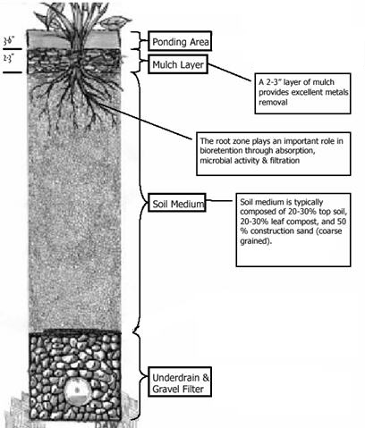
Layers of a Rain Garden
Graphic compliments of Sleepy Creek Watershed Association
Notes:
Mulch/Organic Layer
This material provides for the decomposition of organic material, and also plays an important role in the removal of metals. Shredded hardwood mulch is the preferred choice, since it allows for maximum surface area for binding and resists flotation/washout.
Planting Soil
Organic matter in the form of leaf mulch (20%) blended into a sandy soil (50%) with and about 30% top soil. The planting soil mixture provides a source of water and nutrients for the plants to sustain growth. Clay particles adsorb heavy metals, hydrocarbons and other pollutants

Slide 14
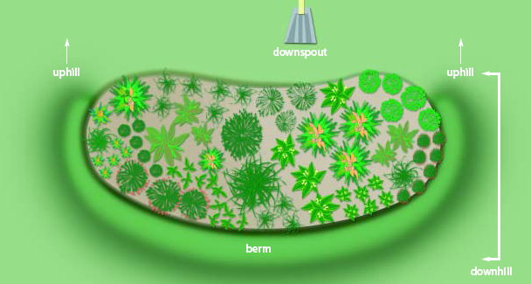
Start Digging!
Again- 3 to 4” depression
Pick a shape!
If your soil lacks organic matter, dig dipper and add 2 to 3 inches of compost or humus.
Level!
Create a berm on lower side of garden to hold water
Use downspout extensions or shallow ditch to direct water into your garden
Graphic from “Rain Gardens- A how-to manual for homeowners

Slide 15
Add Your Plants
Research your plants
Choose drought tolerant plants
Go native!
Consider height, bloom time, color and overall texture
Choose plants that bloom at different times to create longer flowering season
Mix it up
Dig plant hole twice as wide as the plant plug
Not too deep!
Mulch (2” thick)
Water
Integrate stone, ornamental fences, trails or garden benches
Notes:
Highly functional for protecting WQ- should also be an attractive part of your yard and neighborhood. A planting plan design should include species that tolerate extremes. There will be periods of water inundation and very dry periods. Most riparian plant species will do well in rain gardens. The choice of species should include plants that mimic forest habitat and have an aesthetic landscape value such as flowers, berries, interesting leaves or bark. Groundcovers, perennials shrubs, and trees should be incorporated into the planting design

Slide 16
Maintenance
Weeding first two years
Pruning as needed
Leave dead or dormant plants standing and cut back in spring
Mow it!
Work in progress- add to or share your plants

Slide 17
Suggested Plants
Blue-eyed Grass
Black-eyed Susan
Bee Balm
Spicebush
Aster
Butterflyweed
Joe-pye Weed
Switchgrass
Goldenrod
Coneflower
Mountain laurel
Virginia Wild Rye
Rattlesnake Fern
Phlox
Yarrow
Canada Wild Rye
Bottlebrush Grass
Arrow wood
Coreopsis
Veronica
Golden Seal
Solomon’s Seal
Blue stem grass
Hay-scented grass
Cardinal Flower
Sweet Flag

Slide 18
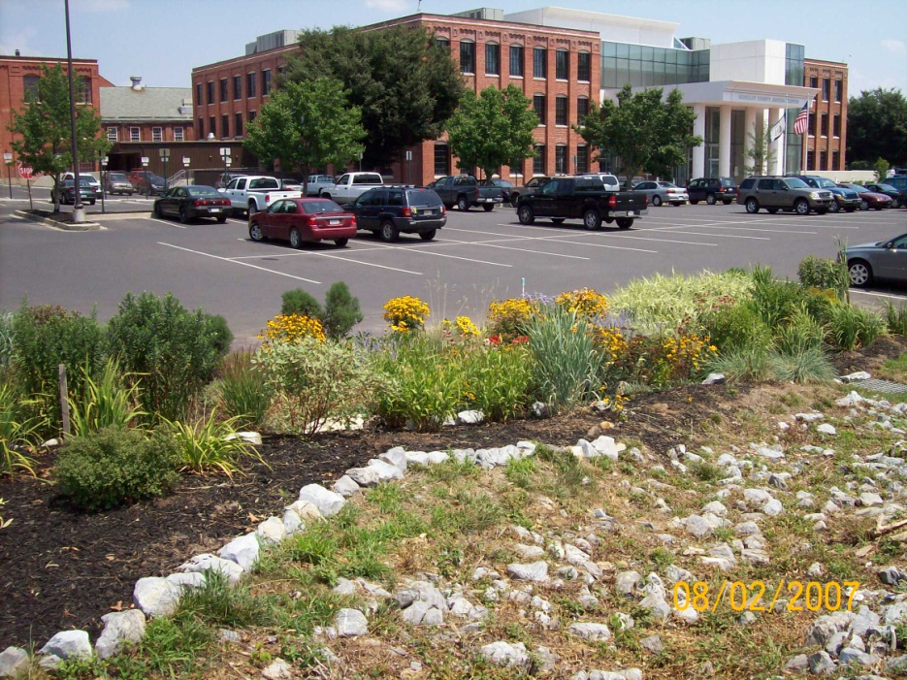
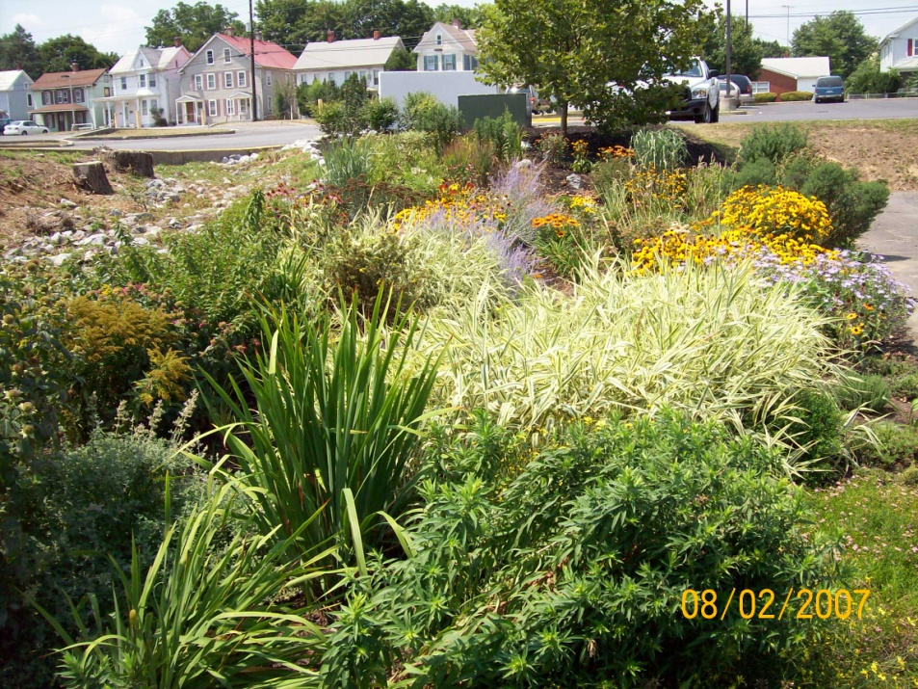
Local Gardens
Berkeley County Judicial Center- Martinsburg, WV
Planted August 2007
Opequon Creek Project Team

Slide 19
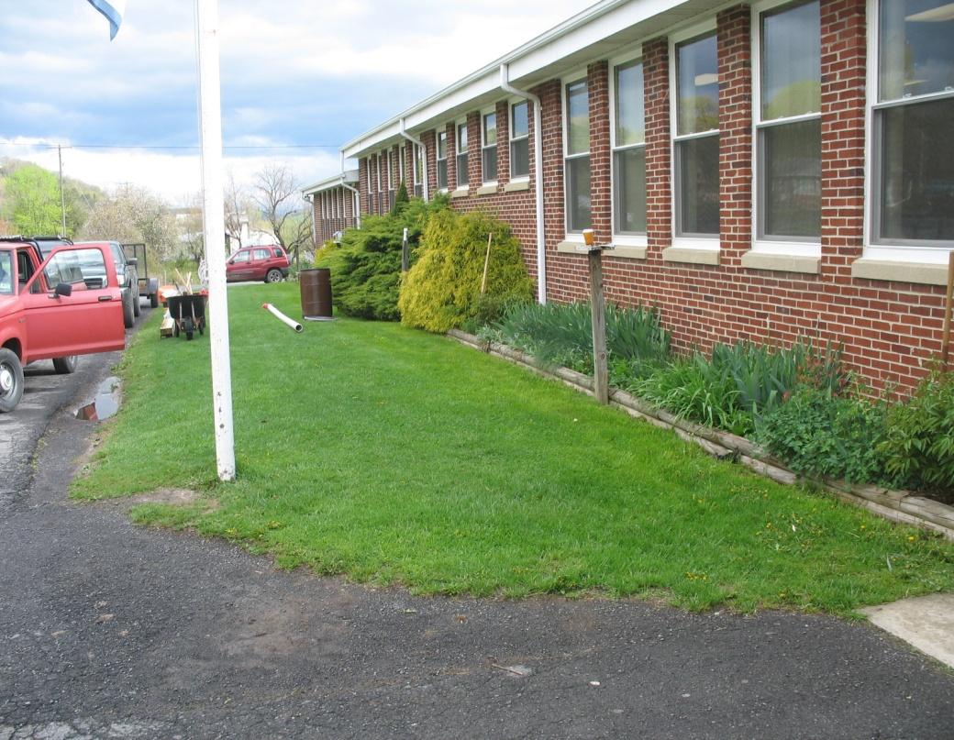
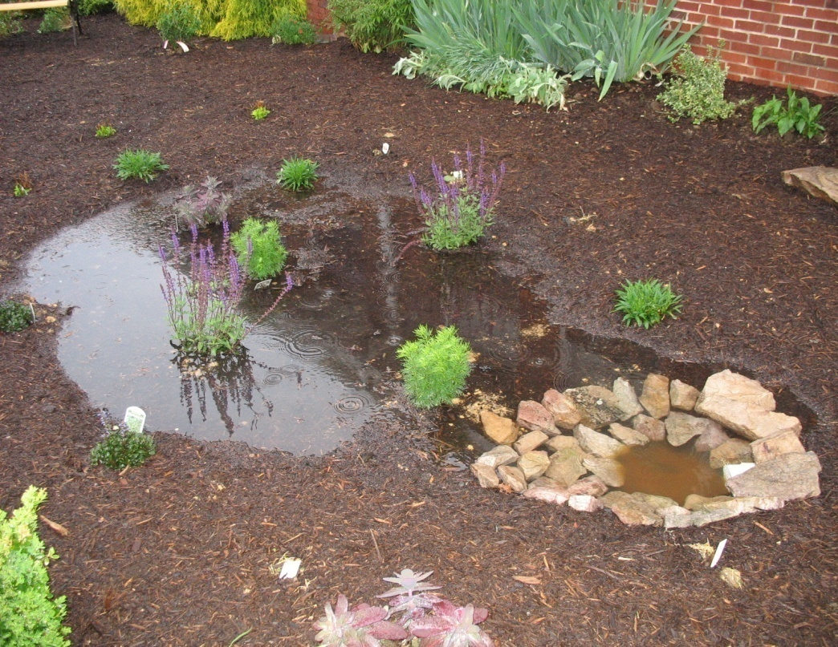
Local Gardens
Dorcas Elementary School- Mill Creek of the South Branch Planted April 2008 in cooperation with local Master Gardeners

Slide 20
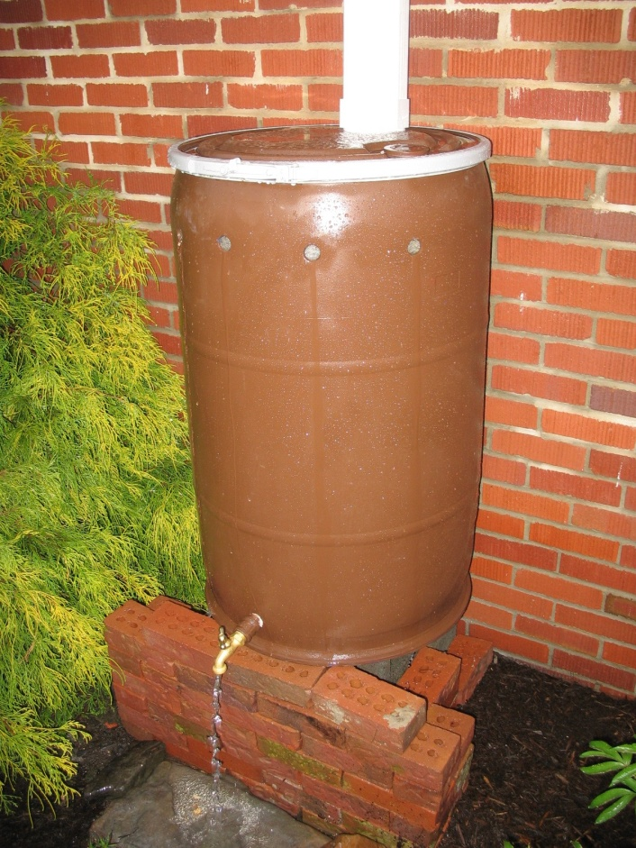
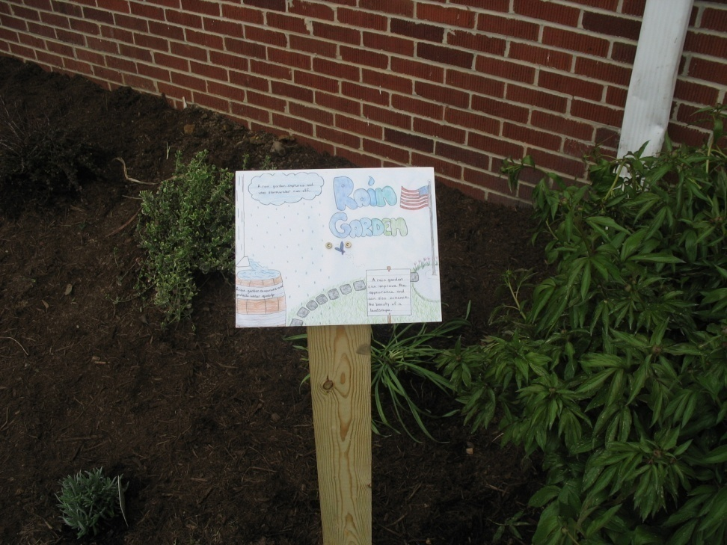
Fun Additions
Fun Interpretive Signage
Add a Rain Barrel- Your plants will thank you!

Slide 21
Why a Rain Barrel?
Water Conservation Benefits
Water usage increases by 30% in summer
Storm water Management
Raise environmental awareness!
They’re FUN!
Notes:
Lower your water bill
Reduce pollution by managmeing stormwater runoff

Slide 22
Compliments of the Opequon Project Team!

Slide 23
For More Information:
West Virginia Conservation Agency
304.538.7581
or
WV Department of Environmental Protection
304.822.7266

